Slide 1
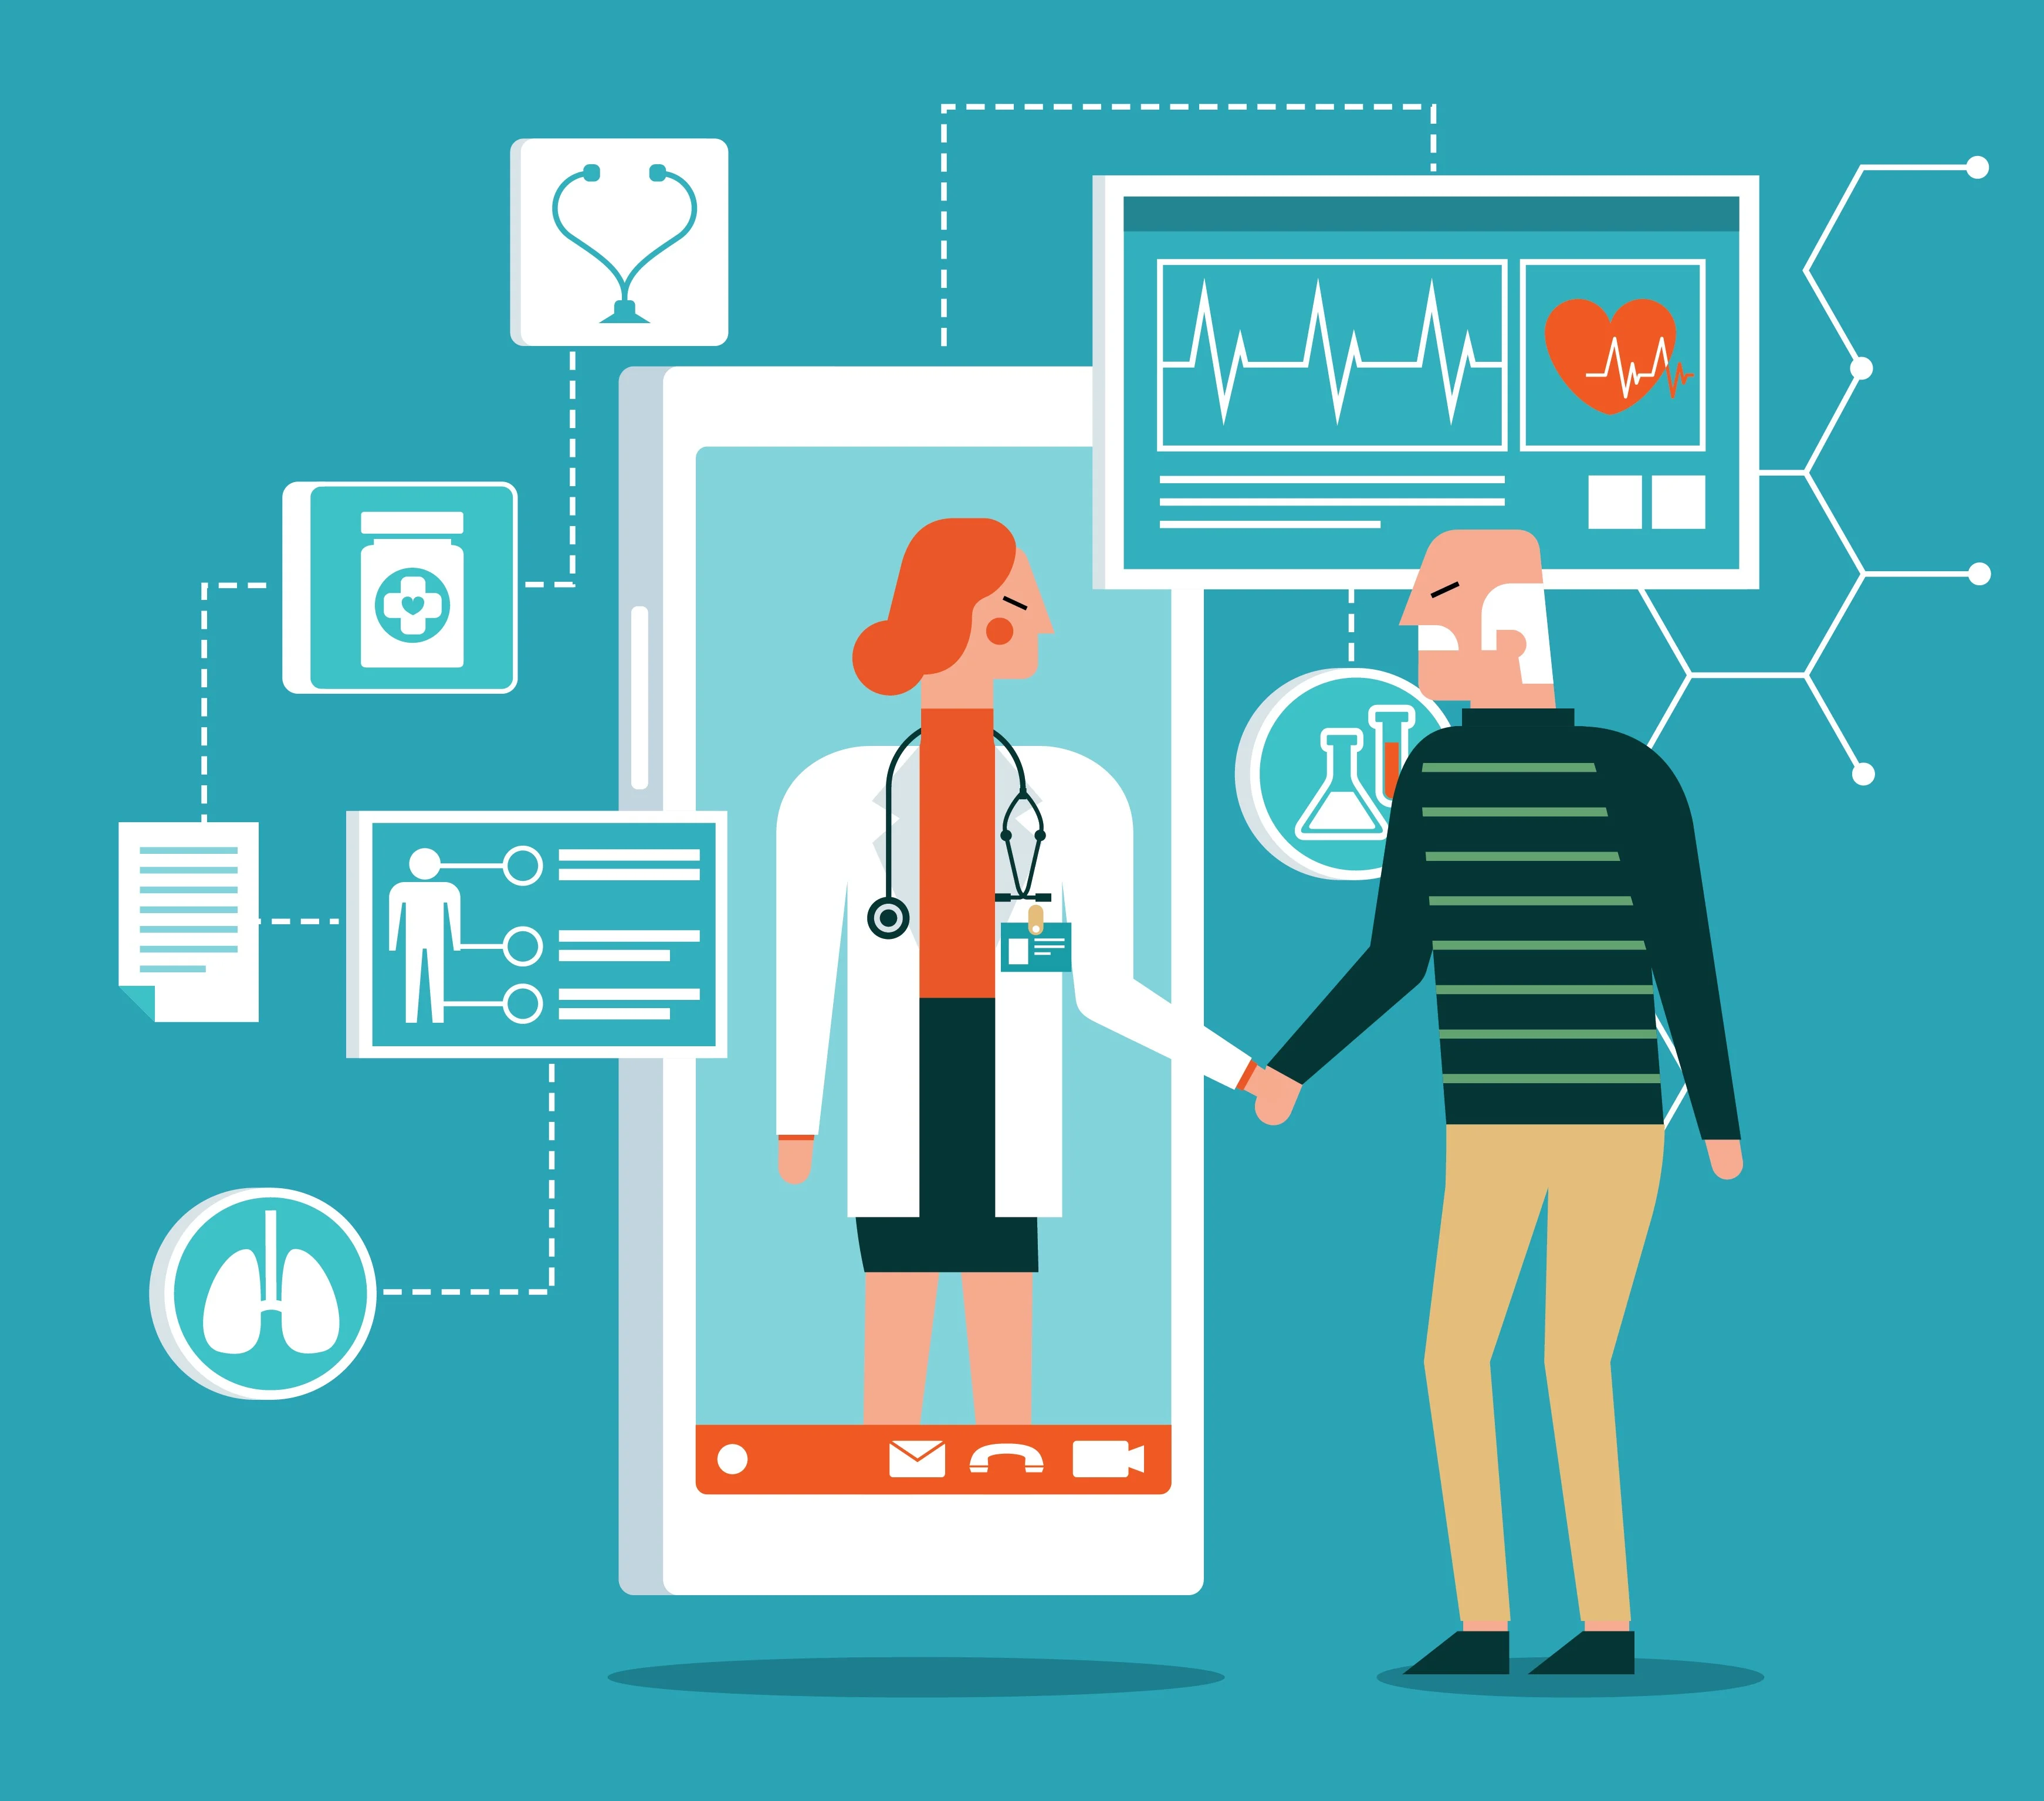
Virtual Assistance for emergency
situations using IoT
06_Akhila Madhavan
S4_MCA-A

Slide 2
Relevance of topic
The IoT allows objects to be sensed and controlled remotely across existing network infrastructure
Creating opportunities for more direct integration of the physical world into computer-based systems.
The last decade has witnessed extensive research in the field of healthcare services and their technological upgradation.
Connecting various medical devices, sensors, and healthcare professionals to provide quality medical services in a remote location.
This has improved patient safety, reduced healthcare costs, enhanced the accessibility of healthcare services,high accuracy and economic benefit and increased operational efficiency in the healthcare industry

Slide 3
Description of the Project
In medical emergencies, the victims are not able to talk about anything regarding themselves. Medical information of patients is not available at that time for doctors. Along with this, victim’s wallet, purses, mobile, cards are frequently separated by them because of theft, or accidents. In these situations, a dedicated device that can provide the ER doctors about the patient's medical information can be very useful. The device can be described as an IOT based ‘virtual assistant’ for providing proper identification and complete medical information of every emergency patient to the ER staff and thus ensure timely and appropriate treatment decisions. It provides personal identity to that victim and medical information such as history, current condition and ensuring that the information gets available to doctors in time of need to ensure safety of family and friends. Also, one can track individual with the help of device with its software application provided with it.

Slide 4
Description of the Project
Technology plays the major role in healthcare not only for sensory devices but also in communication, recording and display device. It is very important to monitor various medical parameters and post operational days. Hence the latest trend in Healthcare communication method using IOT is adapted. Internet of things serves as a catalyst for the healthcare and plays prominent role in wide range of healthcare applications.
In this project, an intelligent home-based platform, the Home Health-IoT, is proposed. In particular, the platform involves health care management system with enhanced connectivity for the integration of devices and services. The proposed platform seamlessly fuses IoT devices (e.g., wearable sensors) with in-home healthcare services (e.g., telemedicine) for an improved user experience and service efficiency.

Slide 5
Objectives
>> Continues monitoring of health parameters of patients or elderly people at home
>> Remote monitoring of patient health via mobile application
>> Reduce human error in accessing health parameters
>> Access data for telemedicine system
>> Reduce post – operation periods at hospitals, hence the cost of treatments
>> Reduce effort of doctors/care takers
>> Automatic alert will send to care taker in case of emergency

Slide 6
Incase of any emergency we need to contact caretaker or
hospital through manually.
Even if the patient is under camera surveilance it can’t detect the temperature , heart beat etc.
And after reaching hospitals , the staff needs to check everything related to the patient for providing proper
identification and complete medical information of every
emergency patient. Which requires more time in complex cases and the patient history may not be available at that time which enhance risk in giving treatments
Existing System

Slide 7
The Proposed System architecture for IOT Healthcare is consist of accelerometer, temperature sensor, heart beat sensor and a spo2 sensor. Sensors acquire the data of various parameters regarding patients’ health using Node MCU module and using the Internet of Things technology, stores that data and displays through the IoT mobile application, which provides access for remote monitoring and GSM module for sending alert /message for emergency contacts .The caretaker will able to select the hospital in case of extended emergency through the mobile application.
Proposed System

Slide 8
Modules
Patient Monitoring
Dangerous deterioration
Alert Sending
Caretaker App Management
Hospital Telemedicine System

Slide 9


Arduino UNO
Node MCU
DHT 11
MPU 6050
MAX 30102
GSM
GPS- Neo 6M
Components

Slide 10
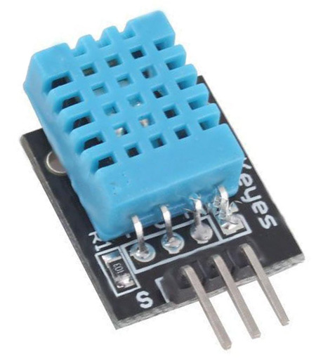
DHT 11

Slide 11
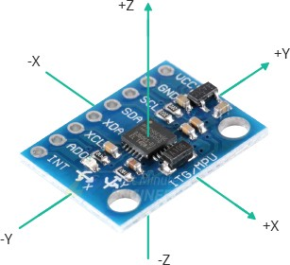
MPU 6050

Slide 12
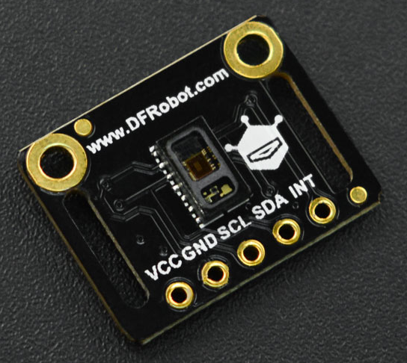
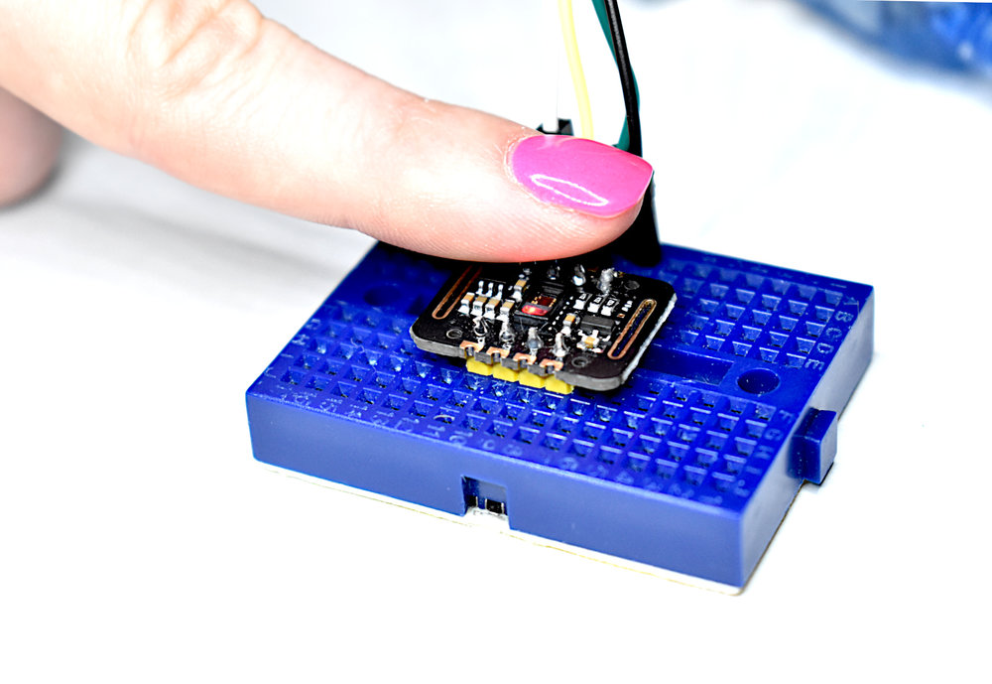
MAX 30102

Slide 13
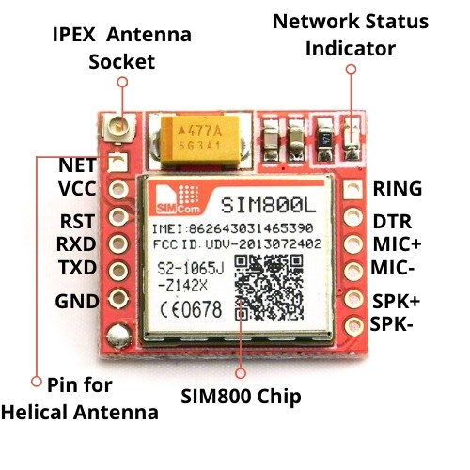
GSM

Slide 14
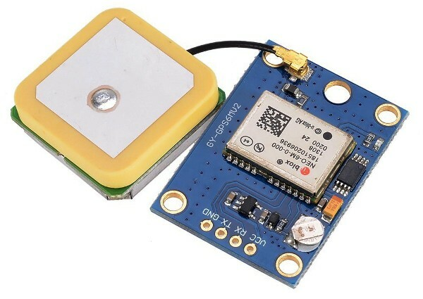
GPS - Neo 6M

Slide 15
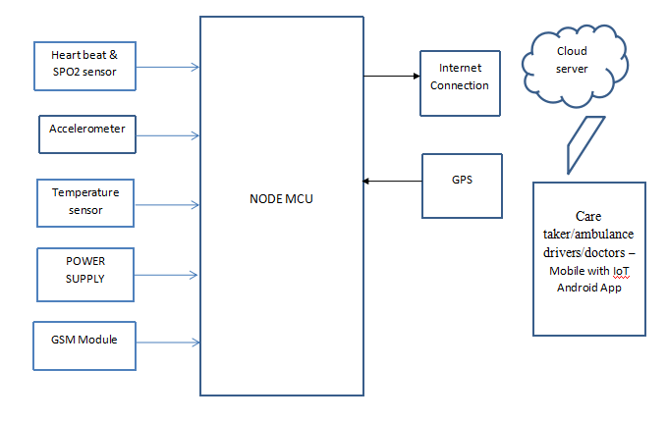
Block Diagram

Slide 16
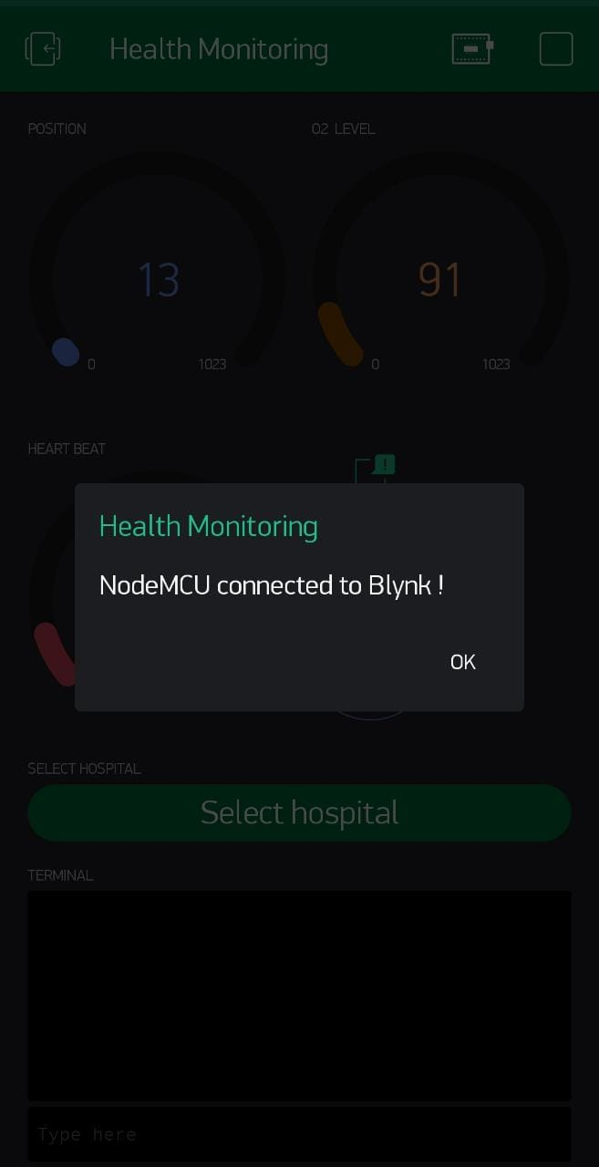
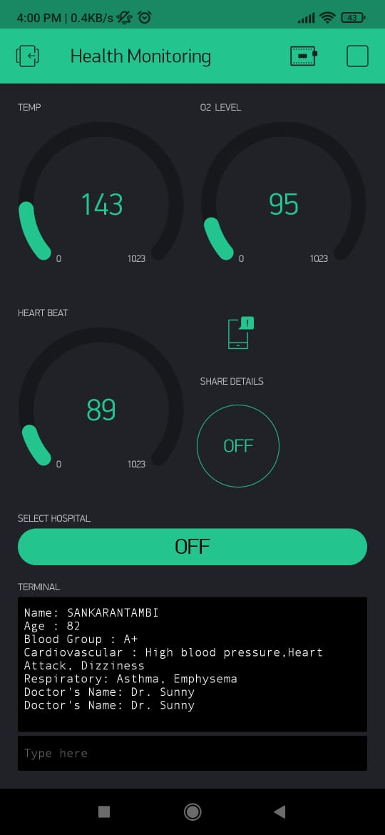
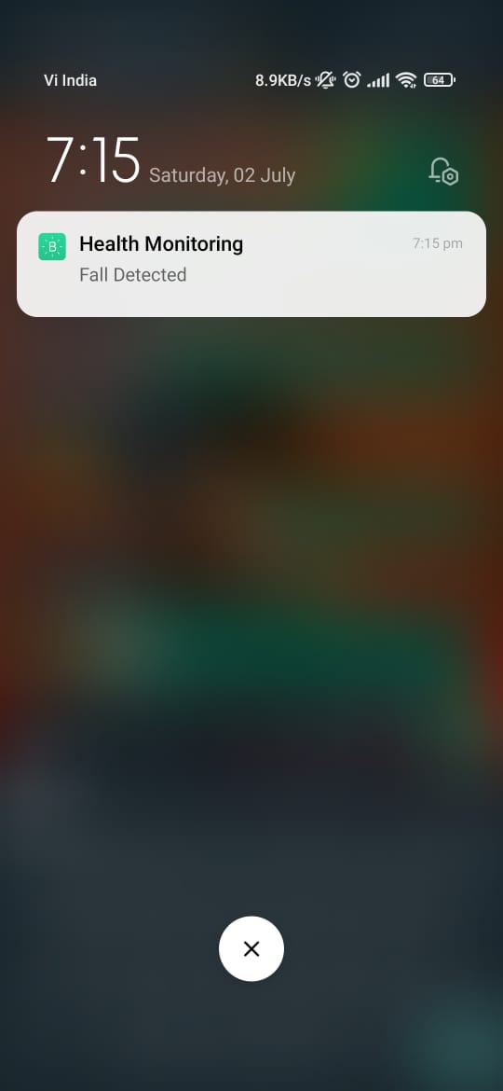
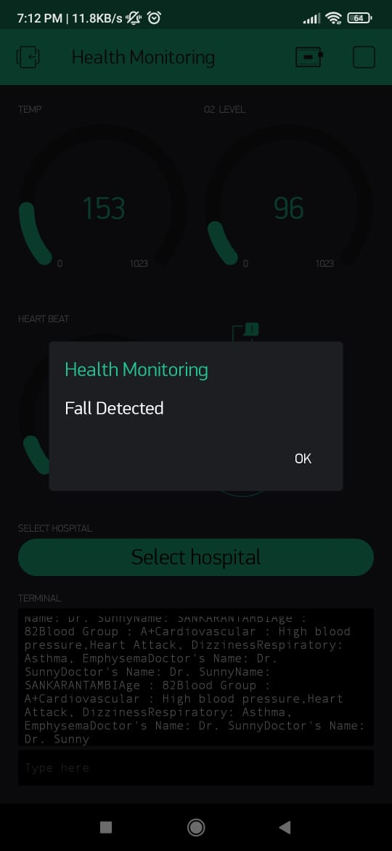
MODEL IS READY TO USE

Slide 17
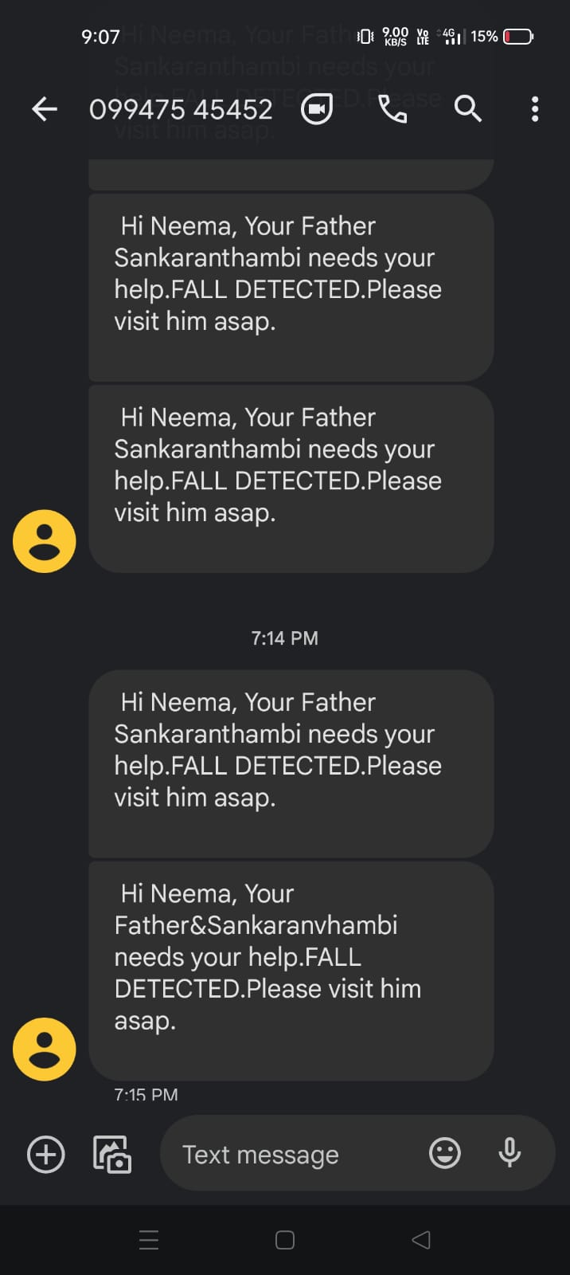
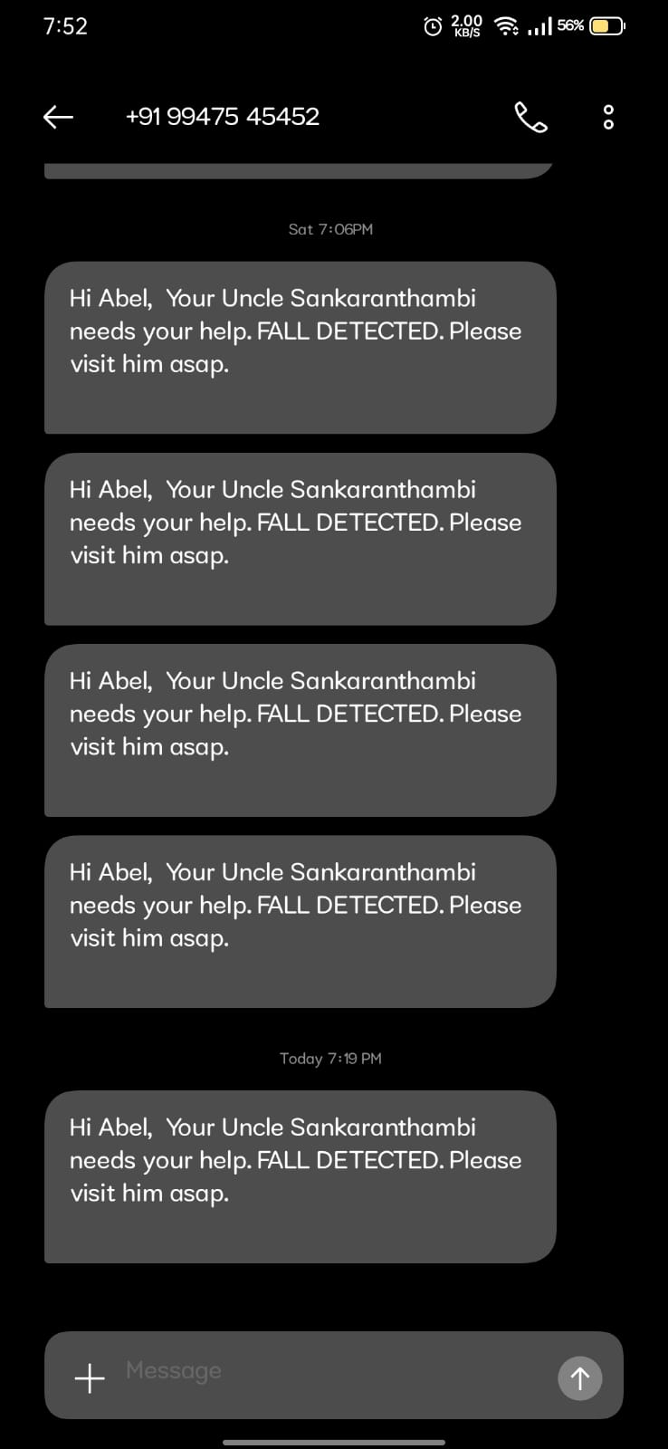
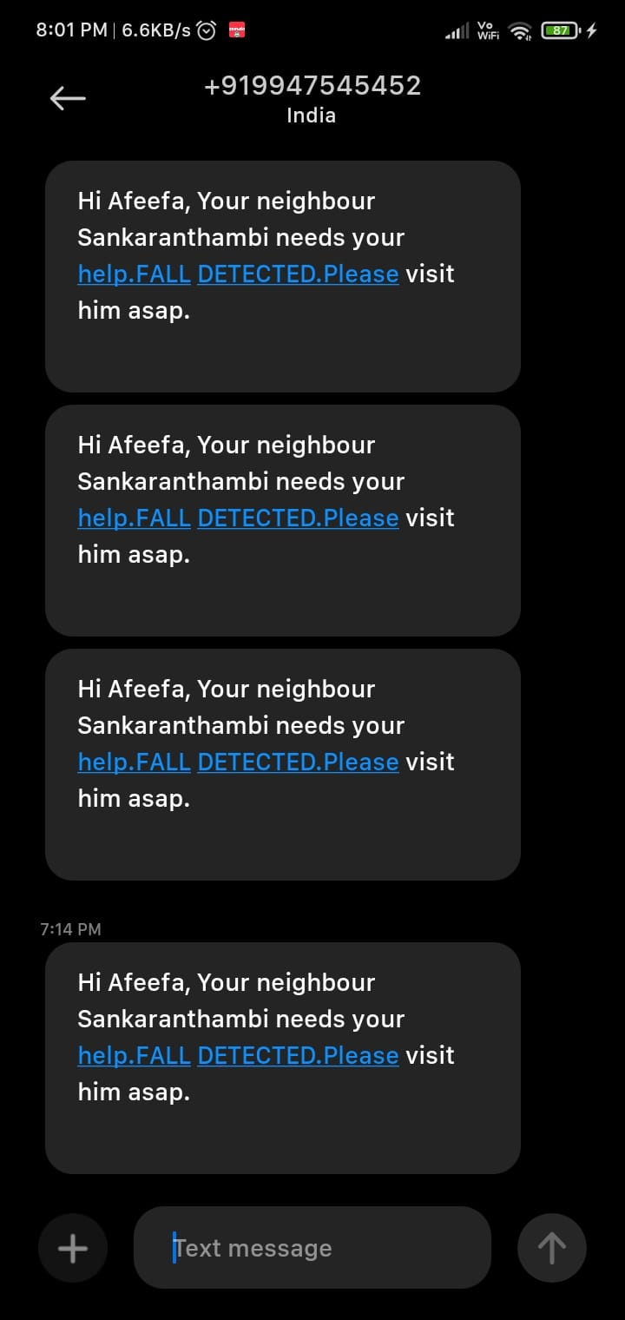
GSM sending alert to emergency contacts

Slide 18
Future Scope
Tracking
Security
Medical history update
Portability
Safety
Online medical support
Bio-sensors in wearable IDs

Slide 19
Application areas :-
1) Household
2) Elderly people
3) School system
4) Medical centers
5) Post Operation Days ( Home nurse- Virtual Nurse)

Slide 20


THANK YOU
Akhila Madhavan
S4 -MCA-A

